Slide 1

Pharmacy Management System
Made by:
Syed Ahmed Mahmood k200153
Alishah Naushad k201078
Abdul Moiz Khan k200150

Slide 2
INTRODUCTION
This application will aid pharmacy managers in stock handling, storing the records of customers that have a membership at the store to provide them a discount at every purchase from the pharmacy. Additionally it generates a bill for every purchase a customer makes and generates a daily report at the end of every work day.

Slide 3
Pharmacy Management System
Customer Record
Management
Stock Management
Billing System
Daily Report

Slide 4

Customer Record Management
1
2
3
4
5
Add Records
View Records
Search Records
Modify Records
Delete Records

Slide 5
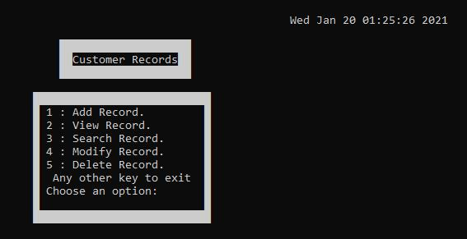
01

Slide 6
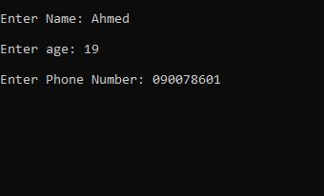
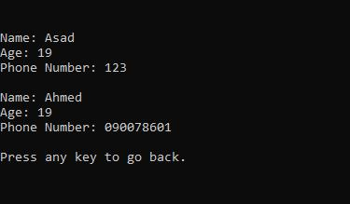
Add record
View record
1
2
Place your screenshot here
Place your screenshot here

Slide 7
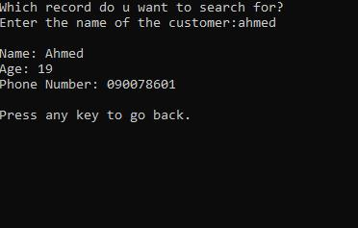
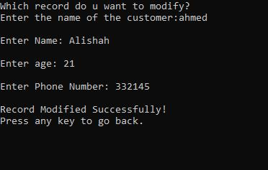
Search record
Modify record
3
4
Place your screenshot here
Place your screenshot here

Slide 8
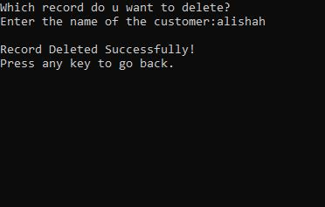
Delete record
5
Place your screenshot here

Slide 9
Stock Management
S
T
O
C
K
S
Add New Inventory
View Existing Inventory
Search Products
01
02
03
Modify Product Details
Remove Products
04
05

Slide 10
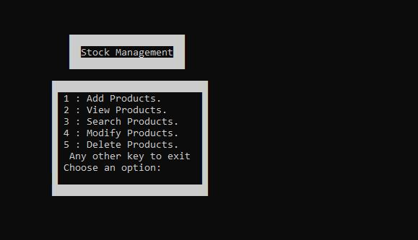
01

Slide 11
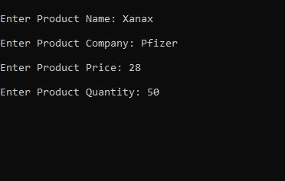
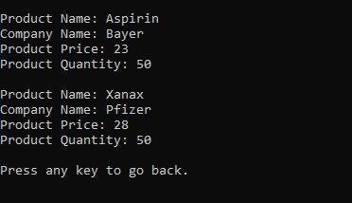
Add Products
View Products
1
2
Place your screenshot here
Place your screenshot here

Slide 12
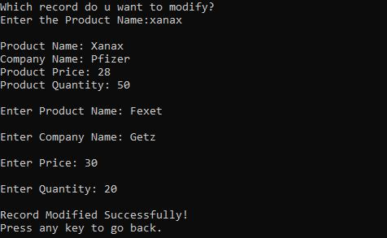
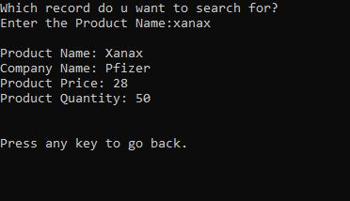
Search Products
Modify Products
3
4
Place your screenshot here
Place your screenshot here

Slide 13
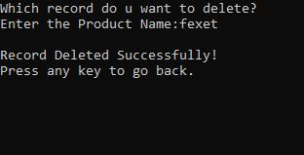
Delete Products
5
Place your screenshot here

Slide 14
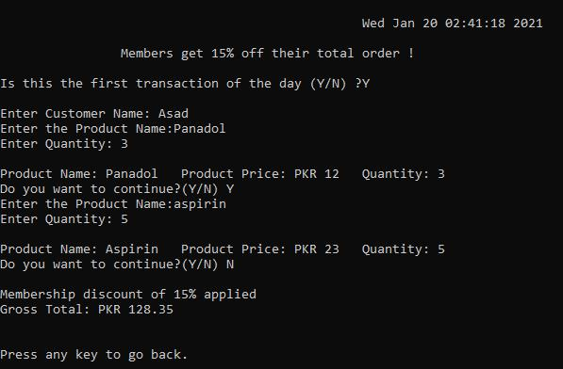
4
1
Customer with a membership gets 15% off their total order
Asks which medicine do they want to purchase
Billing System
2
5
Asks the user if this is the 1st transaction of the day
(for the daily report)
Asks for the quantity of the medicine needed and checks against the database if enough of that medicine are in stock
3
6
Asks the name of the
customer and checks against the database if the customer is a member or not
If the medicine is available and enough quantity is available, the quantity bought is deducted from the inventory in the database. Also asks if they want to buy more medicine

Slide 15


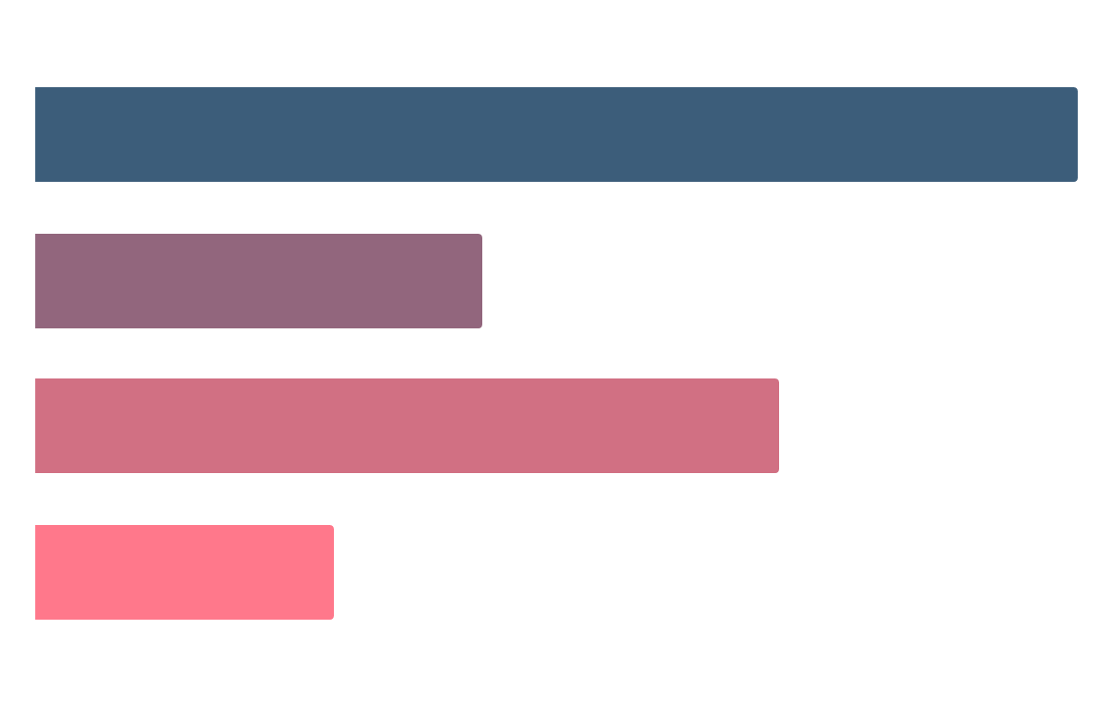
Daily Report
It shows:
After one whole work day is complete the pharmacy manager can choose to get a daily report.
Updated Inventory
Total sales for the day
...

Slide 16

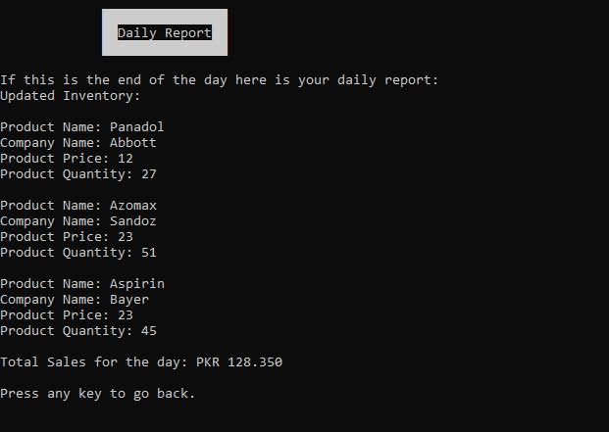

Slide 17
Advantages of the
Pharmacy Management System
Easier to keep track of regular customers and incentivise them to buy more products
No need to manually count and manage stock, inventory updated automatically
Efficient system that makes billing easy and provides daily useful insights for management

Slide 18


